Slide 1

Customer Shopping Behavior Analysis
Uncovering insights from 3,900 transactions to drive strategic retail decisions

Slide 2
Dataset at a Glance
3,900
18
Key Data Points
Customer demographics & subscription status
Purchase Records
Data Dimensions
Purchase details across categories, seasons, sizes
Shopping behavior: discounts, ratings, shipping preferences
50
25
Missing data: 37 values in review ratings (handled via median imputation)
US Locations
Product Types

Slide 3

Data Preparation Pipeline
01
02
Data Loading & Exploration
Cleaning & Standardization
Imported dataset with pandas, examined structure with df.info() and summary statistics
Imputed missing review ratings, renamed columns to snake_case for consistency
03
04
Feature Engineering
Data Integration
Created age_group bins and purchase_frequency_days for deeper segmentation
Connected to PostgreSQL database, loaded cleaned data for SQL analysis

Slide 4
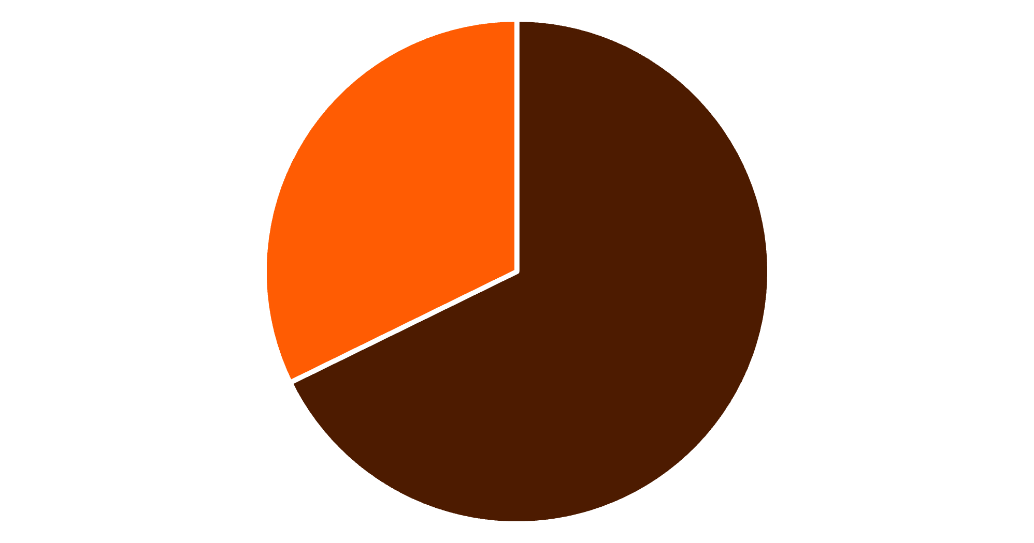
Revenue Distribution by Gender
Male Customers Drive 68% of Revenue
Male shoppers contribute $157,890 vs. $75,191 from female customers—presenting opportunity for targeted campaigns to boost female engagement
Male
Female

Slide 5


Smart Spenders: Discount Users Above Average
839
21.5%
High-Value Discount Shoppers
Share of Total Customers
Customers using discounts while spending above $60 average
Valuable segment that responds to promotions without sacrificing spend
Key Insight: Discounts don't always mean lower revenue—strategic promotions can maintain high purchase values

Slide 6

Product Performance Leaders
Gloves
Sandals
Boots
3.86 rating
3.84 rating
3.82 rating
Top-rated accessory
Summer footwear winner
Cold weather favorite
Hat
Skirt
3.80 rating
3.78 rating
Versatile accessory
Popular apparel choice
Feature these high-rated items prominently in marketing campaigns and product placement

Slide 7



Customer Loyalty Landscape
1
2
3
1
New
2
Returning
3
Loyal
Segment Breakdown
Loyal: 3,116 customers (80%) drive consistent revenue
Returning: 701 customers (18%) show engagement potential
New: 83 customers (2%) need retention strategies

Slide 8
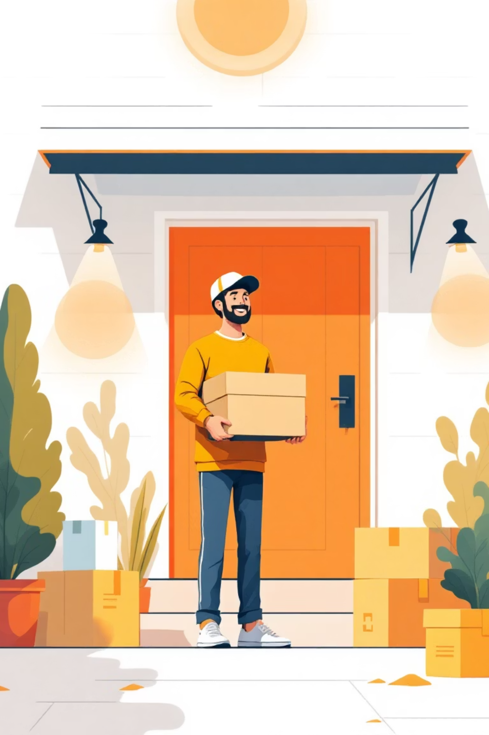
Subscription Economics
Subscribers
1,053 customers
Avg spend: $59.49
Total revenue: $62,645
Non-Subscribers
2,847 customers
Avg spend: $59.87
Total revenue: $170,436
Opportunity: 73% of customers aren't subscribed—massive potential to convert with exclusive benefits and loyalty perks

Slide 9
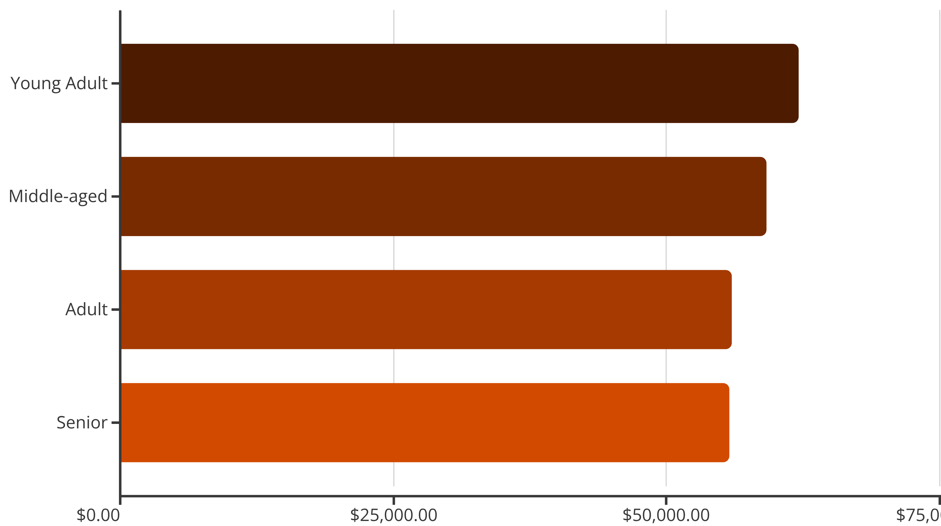
Age Group Revenue Contribution
Revenue is evenly distributed across age groups—each segment contributes 24-27% of total revenue, requiring tailored marketing for all demographics

Slide 10





Strategic Recommendations
Boost Subscriptions
Promote exclusive perks to convert 73% non-subscriber base
Loyalty Rewards
Move returning buyers into loyal segment with incentives
Smart Discounting
Balance promotions with margins—839 high-spenders prove it works
Feature Winners
Highlight top-rated products in campaigns for maximum impact

